Slide 1
DIGITIZATION

Slide 2
INTRODUCTION
Digitization: The process of converting geographic features on a raster image into vector data (points, lines, or polygons) for use in GIS.
Converting paper maps to digital format:
By tracing features like roads, boundaries, and land use from paper maps onto a computer screen, creating vector data that can be easily analyzed and updated in a GIS
Component
Polygon
Polyline
Point

Slide 3
Key aspects of digitization in geomatics:
Scanning:
Converting paper maps into digital images using a scanner.
Georeferencing:
Assigning real-world coordinates to the digitized features on a scanned image.
Vectorization:
Tracing features on a scanned image to create points, lines, and polygons representing geographic elements.
Attribute data entry:
Adding descriptive information (like names, types, or classifications) to each digitized feature.

Slide 4
Application
Urban planning and development:
Digitized data is crucial for planning infrastructure projects, analyzing land use patterns, and assessing potential impacts on the environmen
Environmental monitoring and analysis:
Tracking changes in land cover, vegetation, and environmental parameters using digitized data from satellite imagery or aerial surveys.
Emergency response and disaster management:
Rapidly accessing and analyzing spatial data to identify critical areas during natural disasters and plan effective response strategies.
Cultural heritage preservation:
Digitizing historical maps and documents to preserve cultural information and analyze changes over time.

Slide 5
Method
Create a New Shapefile:
Go to Catalog in ArcMap, right-click on the desired folder, and select New > Shapefile. o Choose Polygon as the feature type and assign the appropriate coordinate system.
2. Start Digitizing: o Add the new shapefile to the map.
Open the Editor toolbar and start editing the shapefile.
Use the Create Features tool to trace the mine lease boundaries on the georeferenced satellite image.
3. Refine the Boundaries:
Use the Snapping tool to ensure precise digitization.
Add vertices at key points to accurately represent the boundaries.
4. Save and Stop Editing:
Save the edits and stop editing once the boundaries are digitized.

Slide 6
Documentation and Analysis
Add Attribute Data:
Open the attribute table of the digitized polygon and add relevant information (e.g., lease ID, area, owner, and date of documentation).
Calculate Area:
Use the Calculate Geometry tool to compute the area of the mine lease polygon.
Export the Data:
Export the digitized boundaries as a shapefile or feature class for further use. Suggested Figures and Tables:

Slide 7
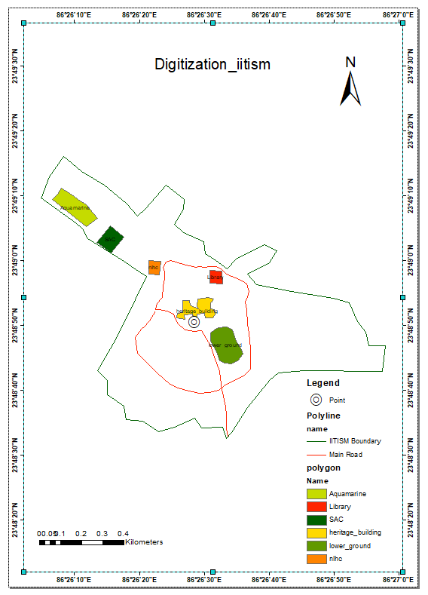
Map generate

